Slide 1
Automated image caption generator using deep learning
Under the supervision of :
Mr. Prem Prakash Agarwal
(Assistant professor)
Submitted By:
GROUP NO: 20IT702
Abhinav Sharma (1709713005)
Hansin Malhotra (1709713044)
Jaskaran Singh (1709713051)

Slide 2
Index
Introduction
Literature Survey
Image Captioning Model
Use Cases
Future Scope
Expected Outcome
References

Slide 3
InTroDUction
Caption generation is an artificial intelligence problem to generate a descriptive sentence for a given image.
Image captioning requires to recognize the important objects
It also needs to generate syntactically and semantically correct sentences.
It involves the dual techniques from understand the content of the image and a language model from the field of natural language processing to turn the understanding into words in the right order.
Applications of image captioning are recommendations in editing applications, usage in virtual assistants, for image indexing, for visually impaired persons, for social media, and several other natural language processing applications.
1

Slide 4
Image Caption Generator
Automatically describe content of an image using CNN (Convolution Neural Networks)
Image to Natural Language using RNN (Recurrent Neural Networks)
Much more difficult than image classification/recognition
Main Inspiration comes from Machine Translation Combine Vision CNN with Language RNN, CNN as encode, RNN as decoder
2

Slide 5
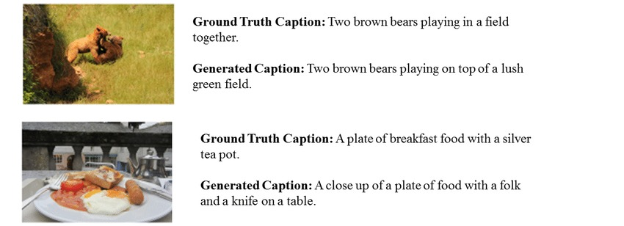
Figure 1: Example of Image captioning
3

Slide 6
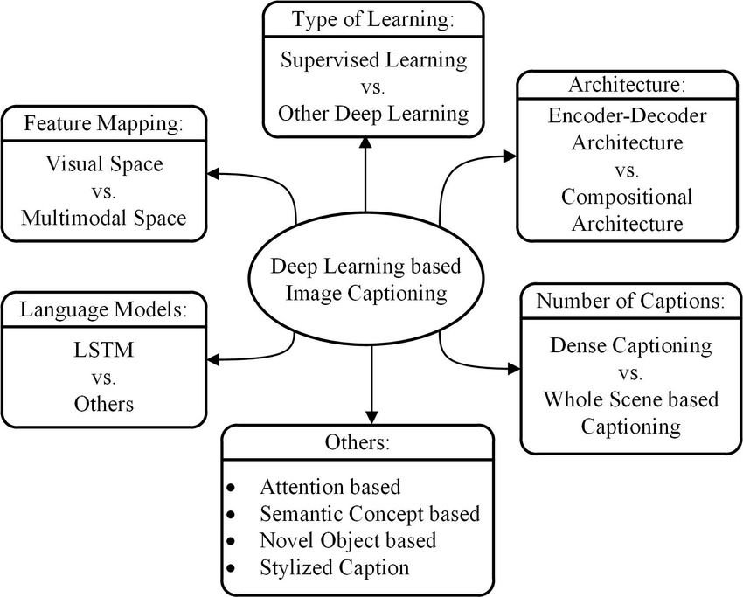
Types of Image Captioning
Figure 2: Different types of Deep learning based Image Captioning
4

Slide 7
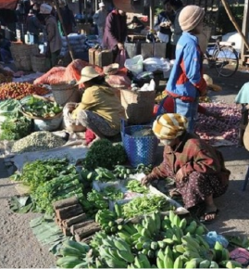
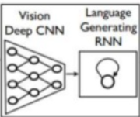
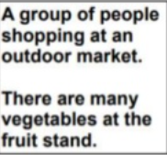
Image taken from http://arxiv.org/abs/1411.4555
Figure 3: Steps of converting Image to captions
5

Slide 8
Literature Review
S.No | Research Paper | Observation | Limitations | Author | Year
1 | Image Captioning: Transforming Objects into Words | The proposed approach shows how to identify the objects and its position in the image. | It is not capable of making sentences. | Simao Herdade, Armin Kappeler, Kofi Boakye, Joao Soares | 2019
2. | Visual to text : Survey of image and video captioning | Visual to text technique highly depend on the training data in terms of both quality and quantity. | Long standing gap semantic gap between computable low level feature and semantic information that they encode. | Sheng Li , Zhiqiang Tao | 2019
3. | Camera2Caption: A real time image caption | By making use of Inception architecture and by simplifying overall flow design, this model works good in real time image captioning | This model doesn’t use visual attention which makes inference process slower. | Aayush Yadav | 2017
4. | Show and Tell: A Neural Image Caption Generator | It is an end to end neural network system that can automatically view an image and generate a reasonable description in plain English. | This model might generate diverse sentences but it might not able to generate quality sentence. | Alexander Toshev Oriol Vinyals Samy Bengio Dumitru Erhan | 2015
6

Slide 9
Captioning Model
A captioning model relies on two main components, a CNN and an RNN. Captioning is all about merging the two to combine their most powerful attributes i.e. CNN and RNN
CNNs (Convolution Neural Networks) excel at preserving spatial Information and recognize objects in Images.
RNNs (Recurrent Neural Networks) work well with any kind of sequential data, such as generating a sequence of words.
So by merging the two, you can get a model that can find patterns and images, and then use that information to help generate a description of those images.
7

Slide 10
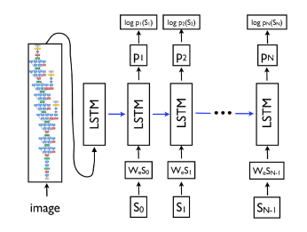
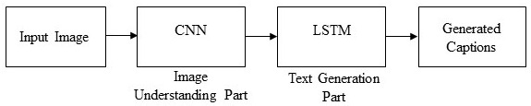
Image Captioning Model
Figure 4: Ilustration of the Google NIC model
8

Slide 11
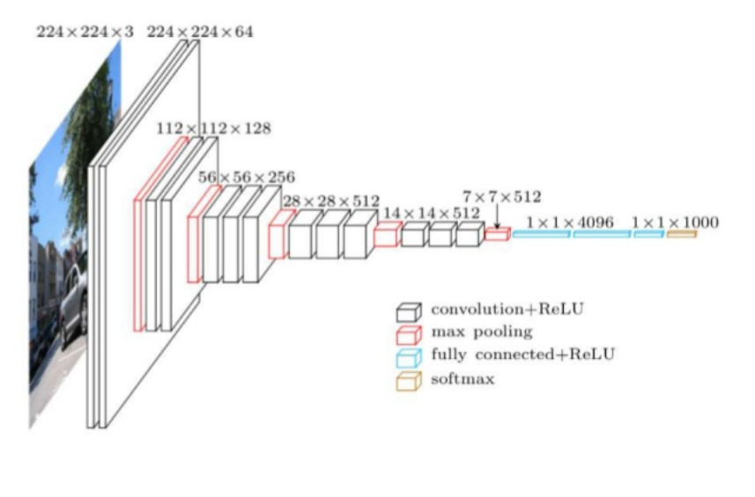
CNn Model
A Convolutional Neural Network is a Deep Learning algorithm which can take in an input image, assign importance to various aspects/objects in the image and be able to differentiate one from the other
Feed an image to CNN. Can use a pre-trained network like VGG 16 or Resnet or ALexaNet.
Figure 5: Process of Pooling Layers in CNN model
9

Slide 12
Use cases
Aid to the blind- We can create a product for the blind which will guide them travelling on the roads without the support of anyone else. We can do this by first converting the scene into text and then the text to voice. Both are now famous applications of Deep learning.
Self Driving Cars – Automatic driving is one of the biggest challenges and if we can properly caption the scene around the car, it can give a boost to the self driving system.
10

Slide 13
Automatic Captioning can help, make Google Image Search as good as Google Search, as then every image could be first converted into a caption and then search can be performed based on the caption.
In Web Development, it’s good practice to provide a description for any image that appears on the page so that an image can be read or heard as opposed to just seen. This makes web content accessible.
CCTV cameras are everywhere today, but along with viewing the world, if we can also generate relevant captions, then we can raise alarms as soon as there is some malicious activity going on somewhere. This could probably help reduce some crime or accidents.
It can be used to describe video in real time.
11

Slide 14
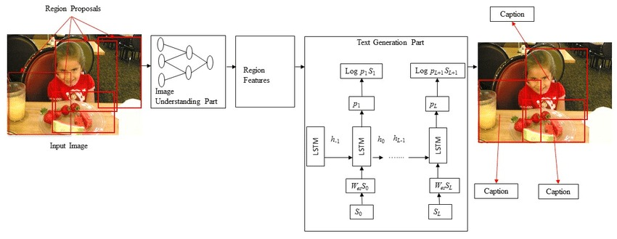
Architecture
Figure 6: Architecture of Image Captioning Generator
12

Slide 15
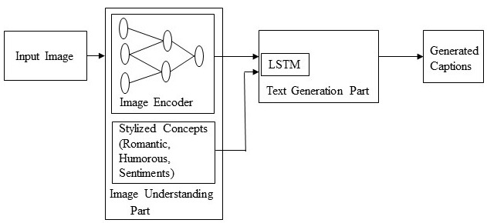
To leverage this potential to natural language, a usual method is to extract sequential information and convert them into language.
For this task, an LSTM-based Recurrent Neural Network is used as a decoder to convert encoded features to natural language descriptions.
In most recent image captioning works, they extract feature map from top layers of CNN, pass them to some form of RNN and then use a softmax to get the score of the words at every step.
Figure 7: Flow of control
13

Slide 16
RELATED WORK
1. Visual to Text : Survey of Image and Video Captioning
Authors: Sheng Li 2 , Member, IEEE, Zhiqiang Tao , Kang Li, and Yun Fu, Fellow, IEEE
This paper classify existing methods by their mechanism to link visual information (including both images and videos)and text descriptions, and emphasize the latest advances on deep learning based approaches. The visual to text techniques aim at accurately describing visual contents using natural language descriptions. One well known challenge is the long-standing semantic gap between computable low-level features and semantic information that they encode. In this paper, It gave a comprehensive survey of relevant work on this topic.
Future Work: 1. To use most advanced supervised machine learning techniques on large-scale visual-text aligned data sets.
2. How to build large scale image and video datasets with accurate and diverse text descriptions in an effective manner.
14

Slide 17
2. Show and Tell: Image Caption Generator
Authors: Oriol Vinyals, Alexander Toshev, Samy Bengio, Dumitru Erhan
This paper had presented NIC, an end-to-end neural network system that can automatically view an image and generate a reasonable description in plain English. NIC is based on a convolution neural network that encodes an image into a compact representation, followed by a recurrent neural network that generates a corresponding sentence.
3. Image Captioning based on Deep Neural Networks
Authors: Shuang Liu, Liang Bai, Yanli Hu and Haoran Wang
The text description of the image can improve the content-based image retrieval efficiency, the expanding application scope of visual understanding in the fields of medicine, security, military and other fields, which has a broad application prospect.
15

Slide 18
4. Camera2Caption: A Real-Time Image Caption Generator
Authors: Pranay Mathur, Aman Gill, Aayush Yadav, Anurag Mishra and Nand Kumar Bansode
By making use of Inception architecture and by simplifying the overall flow design, They had optimized model to perform well in real time (on mobile devices) and manage to obtain high quality captions.
5. Automated Neural Image Caption Generator for Visually Impaired People
Authors: Christopher Elamri, Teun de Planque
Static images can only provide blind people with information about one specific instant of time, while video caption generation could potentially provide blind people with continuous real time information. LSTMs could be used in combination with CNNs to translate videos to English descriptions.
16

Slide 19
6. Deep Learning based Automatic Image Caption Generation
Authors: Varsha Kesavan, Vaidehi Muley, Megha Kolhekar
It is based on a convolution neural network that encodes an image into a compact representation, followed by a recurrent neural network that generates a corresponding sentence. The model is trained to maximize the likelihood of the sentence given the image.
7. Image Caption Generation using Deep Learning Technique
Authors: Chetan Amritkar, Vaishali Jabade
It is conclusive that use of larger datasets increases performance of the model. The larger dataset will increase accuracy as well as reduce losses. Also, it shows that how unsupervised data for both images as well as text can be used for improving the image caption generation approaches.
17

Slide 20
8. Image Captioning: Transforming Objects into Words
Authors: Simao Herdade, Armin Kappeler, Kofi Boakye, Joao Soares
This paper presented the Object Relation Transformer, a modification of the conventional Transformer, specifically adapted to the task of image captioning. The proposed Transformer encodes 2D position and size relationships between detected objects in images, building upon the bottom-up and top down image captioning approach. They also presented qualitative examples of how incorporating this information can yield captioning results demonstrating better spatial awareness. At present, this model only takes into account geometric information in the encoder phase.
Future Work: They intend to incorporate geometric attention in their decoder cross-attention layers between objects and words.
18

Slide 21
Expected Outcome
We have presented AICG, an end-to-end neural network system that can automatically view an image and generate a reasonable description in plain English. AICG is based on a convolution neural network that encodes an image into a compact representation, followed by a recurrent neural network that generates a corresponding sentence. The model is trained to maximize the likelihood of the sentence given the image. Experiments on several datasets show the robustness of AICG in terms of qualitative results
19

Slide 22
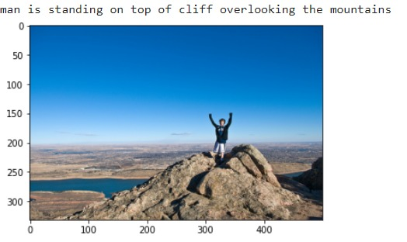
Expected outcome
Word | Neighbours
Car | van, cab, suv, vehicule, jeep
Boy | toddler, gentleman, daughter, son
Street | road, streets, highway, freeway
Horse | pony, donkey, pig, goat, mule
computer | computers, pc, chip, compute
20

Slide 23
FUTuRE SCOPE
To use most advanced supervised machine learning techniques on large-scale visual-text aligned data sets.
. How to build large scale image and video datasets with accurate and diverse text descriptions in an effective manner.
21

Slide 24
References
www.deeplearning.ai
www.tensorflow.org
Donahue, Jeffrey, et al. ”Long-term recurrent convolutional networks for visual recogni-tion and description.” Proceedings of the IEEE conference on computer vision and pattern recognition. 2015.
Simonyan, Karen, and Andrew Zisserman. ”Very deep convolutional networks for large-scale image recognition.” arXiv preprint arXiv:1409.1556 (2014).
Yao, Benjamin Z., et al. ”I2t: Image parsing to text description.” Proceedings of the IEEE 98.8 (2010): 1485-1508.
22

Slide 25
Thank you

